Slide 1

Life Expectancy Time Series Analysis
Tim Cabaza and Renu Karthikeyan

Slide 2
About the Dataset
This data is from Makeover Monday, with GDP and Population data from World Bank Organization.
This dataset comprises of Life Expectancy at birth by country from (1960-2015). We narrowed down our research to compare the United States and Mexico.
Notes:
Some countries had missing values, so we went with countries that had no missing values such as United States & Mexico

Slide 3
Motivation
The motivation of this analysis is to use time series techniques to identify a useful model to forecast Life Expectancy based on numerical predictors such as population and GDP.
Stakeholders:
Governments
International Organizations
Researchers and Academics
Insurance Companies
Economists
Health Care Professionals
Notes:
These models might be useful to Stakeholders to get a snapshot of population health & mortality
governments can use to get a snapshot of population health & mortality in their countries. It can also be used by international organizations like the World Health Organization (WHO), United Nations (UN) and world bank to monitor global health trends.

Slide 4
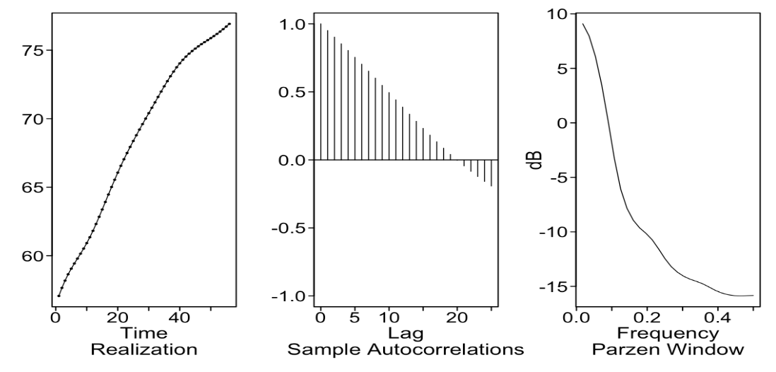
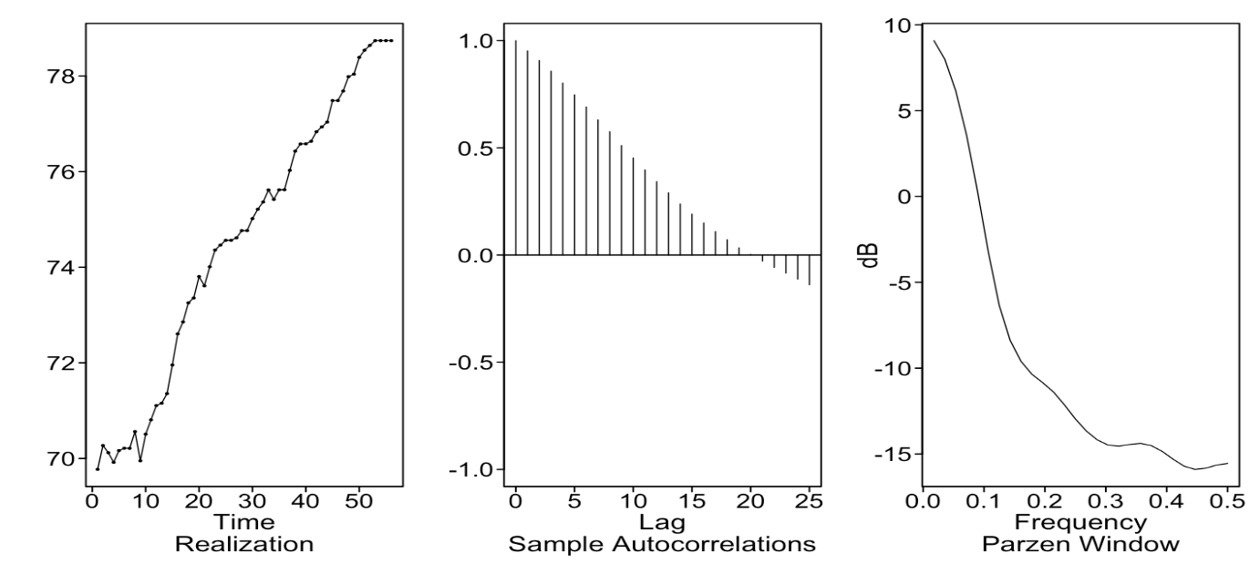
Plotting Realizations of Life Expectancy, GDP, and Population
Mexico
United States
Life Expectancy
Life Expectancy
Notes:
Both countries seem to show slight wandering upward trending Life Expectancy realizations. ACFs are slowly dampening and the Parzen spectral densities have peaks at 0 indicating that the realization is wandering. It does not seem to be stationary:
Stationarity implies that the statistical properties of the data (such as mean, variance, and autocovariance) remain constant over time. The realization shows wandering. However, the ACFs are slowly dampening, maybe indicating that there are some elements of stationarity.

Slide 5
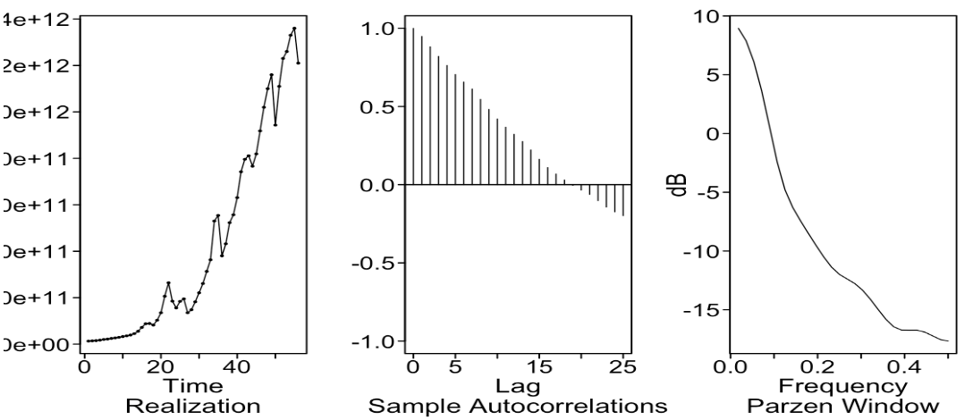
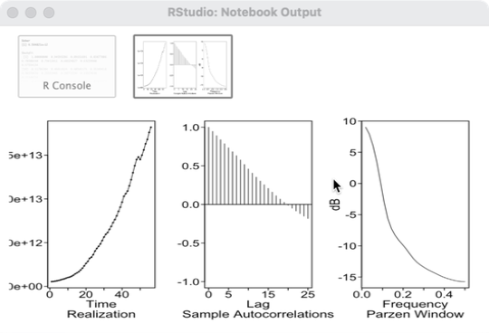
Plotting Realizations of Life Expectancy, GDP, and Population
Mexico
United States
GDP
GDP
Notes:
Both countries seem to have upward trending GDP, it looks like the right half of a parabolic curve (may indicate a quadratic root?). The ACFs are slowly dampening, and there is a peak at 0.0 Frequency implying that it is wandering

Slide 6
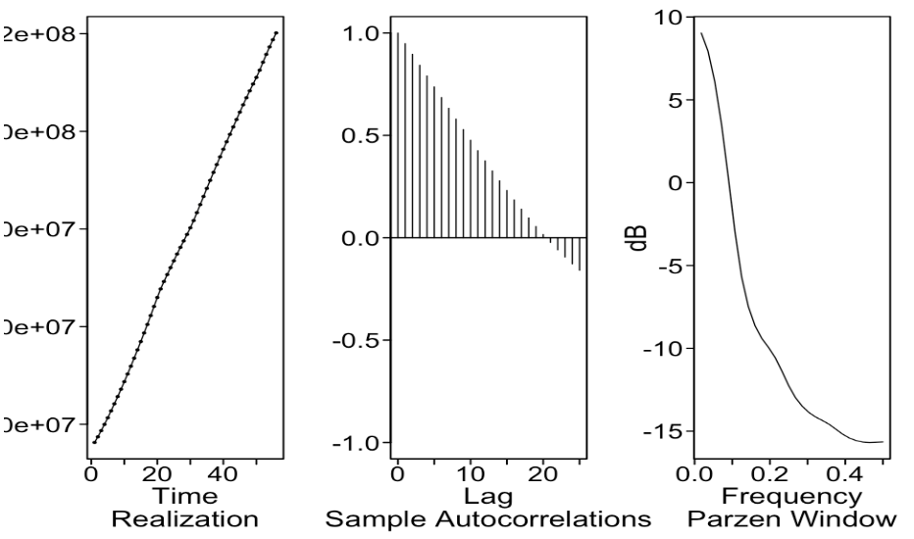
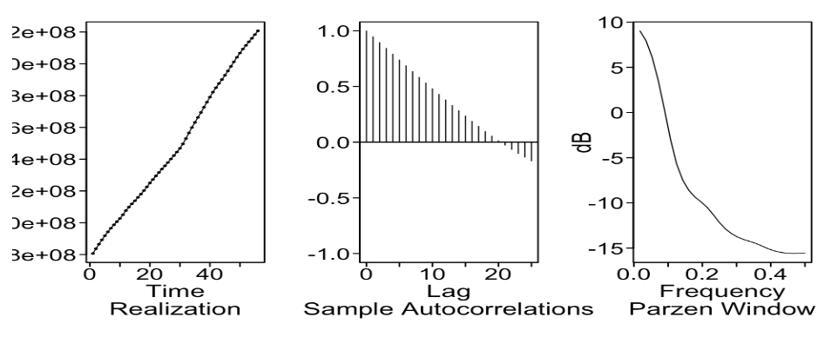
Plotting Realizations of Life Expectancy, GDP, and Population
Mexico
United States
Population
Population
Notes:
The realization for Population seems to be linear for both Mexico and the United States. Like the ACFs and Spectral density for GDP & Life Expectancy, population follows the same pattern of slowly dampening ACFs and peaks near 0 for Spectral Density.

Slide 7
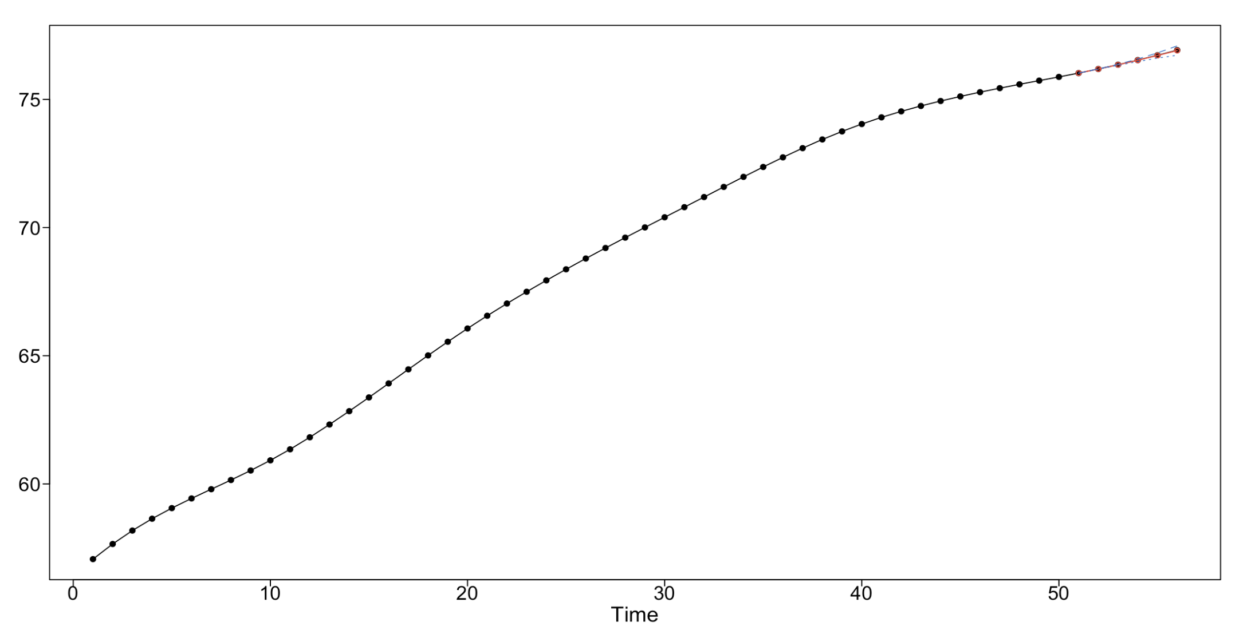
ARMA Models for Mexico
ARMA (5,2)
Short term Forecast of 5
ARMA (5,2) – Model 1 Mexico
5-year ASE | 0.00007811939
5 year Rolling Window RMSE | 0.05
Notes:
To find ideal ARMA Models, we used BIC instead of AIC - because BIC penalizes and is more defendable
When we zoom in, we can see that the ARMA(5,2) model is very close in its prediction for the 5 years; Only mention ASE

Slide 8
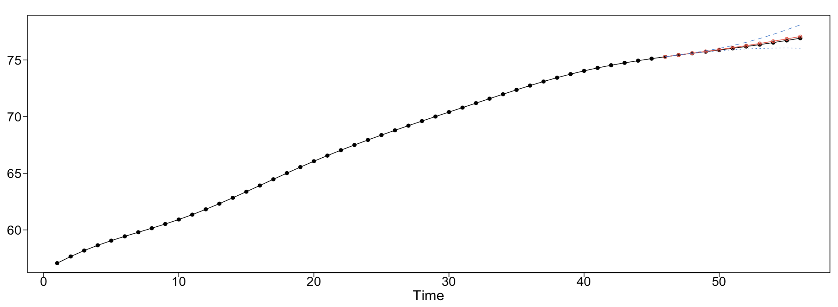
ARMA Models for Mexico
ARMA (5,2)
Long term Forecast of 10
ARMA (5,2) – Model 1 Mexico
5-year ASE | 0.00007811939
5 year Rolling Window RMSE | 0.05
10-year ASE | 0.007747863
10-year Rolling Window RMSE | 0.269
Notes:
Here, in the zoomed in look, we can see that the 10 year is mostly accurate, but slightly deviates from the actuals in the last 3 to 4 points

Slide 9
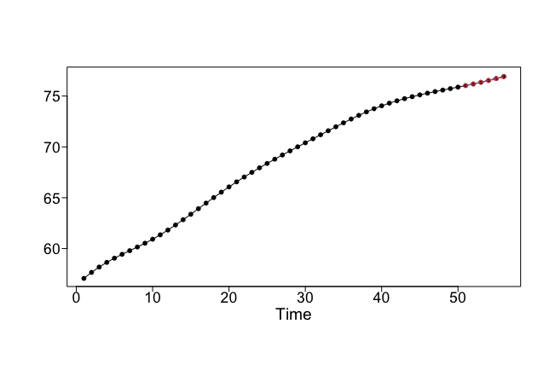
ARMA Models for Mexico
ARMA (5,4)
Short term Forecast of 5
ARMA (5,4) – Model 2 Mexico
5-year ASE | 0.00011528
5 year Rolling Window RMSE | 0.033
Notes:
Like the first model, the 5 year forecast seems to be mostly accurate

Slide 10
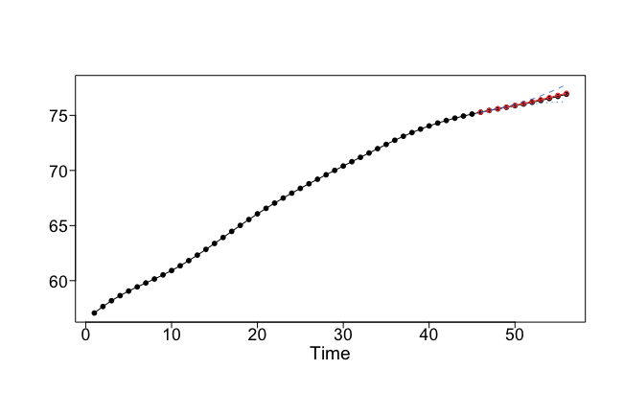
ARMA Models for Mexico
ARMA (5,4)
Long term Forecast of 10
ARMA (5,4) – Model 2 Mexico
5-year ASE | 0.00011528
5 year Rolling Window RMSE | 0.033
10-year ASE | 0.004462134
10-year Rolling Window RMSE | 0.181
Notes:
Zoomed in 10 year forecast seems to be more accurate, with a slight deviation (if any) in the last couple of points

Slide 11
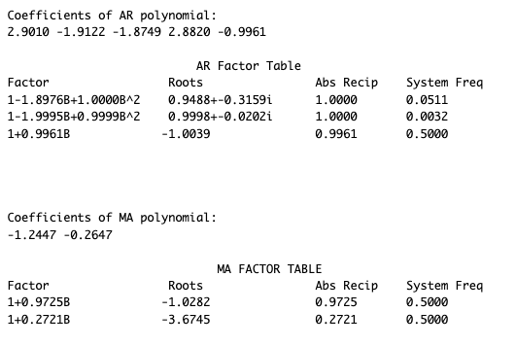
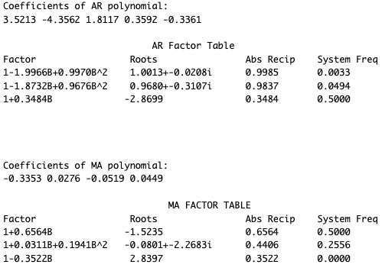
Factor Tables for Mexico ARMA models
Model 1: ARMA (5,2)
Model 2: ARMA (5,4)
Notes:
Model 1 and 2 have 2 imaginary roots in the AR side
2 roots on AR side with absolute reciprocals of 1, system frq has peaks close to 0
Model 2 has an imaginary root in the MA side
2 roots on AR side with abs reciprocals close to 1, system frq has peaks closer to 0, indicating wandering behavior

Slide 12
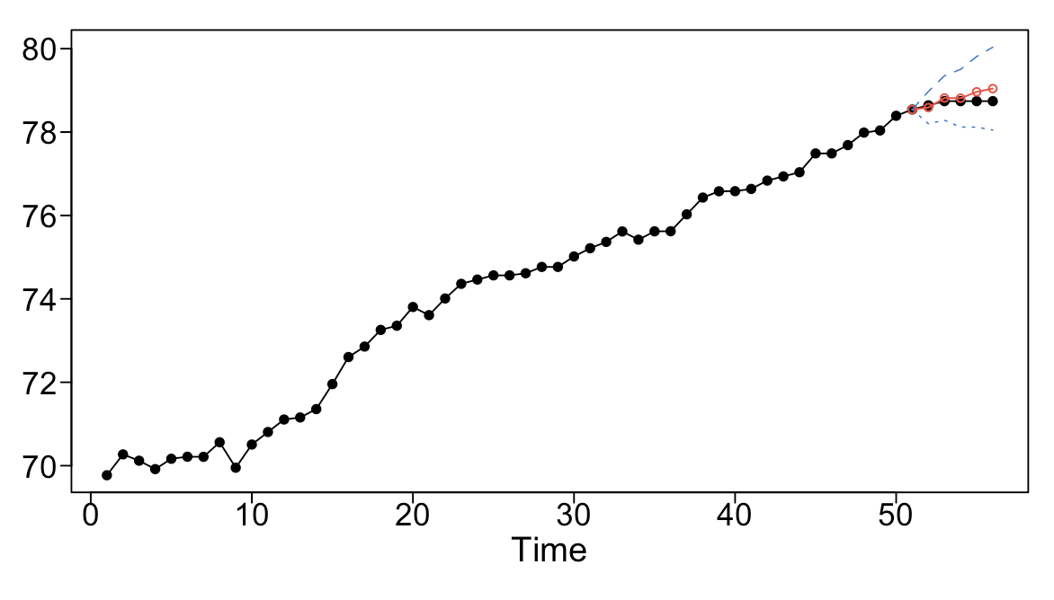
ARMA Models for United States
ARMA (7,1)
Short term Forecast of 5
ARMA (7,1) – Model 1 United States
5-year ASE | 0.03084328
5 year Rolling Window RMSE | 0.355
Notes:
The zoomed in first model, we can see its mostly accurate except for the last 3 points

Slide 13
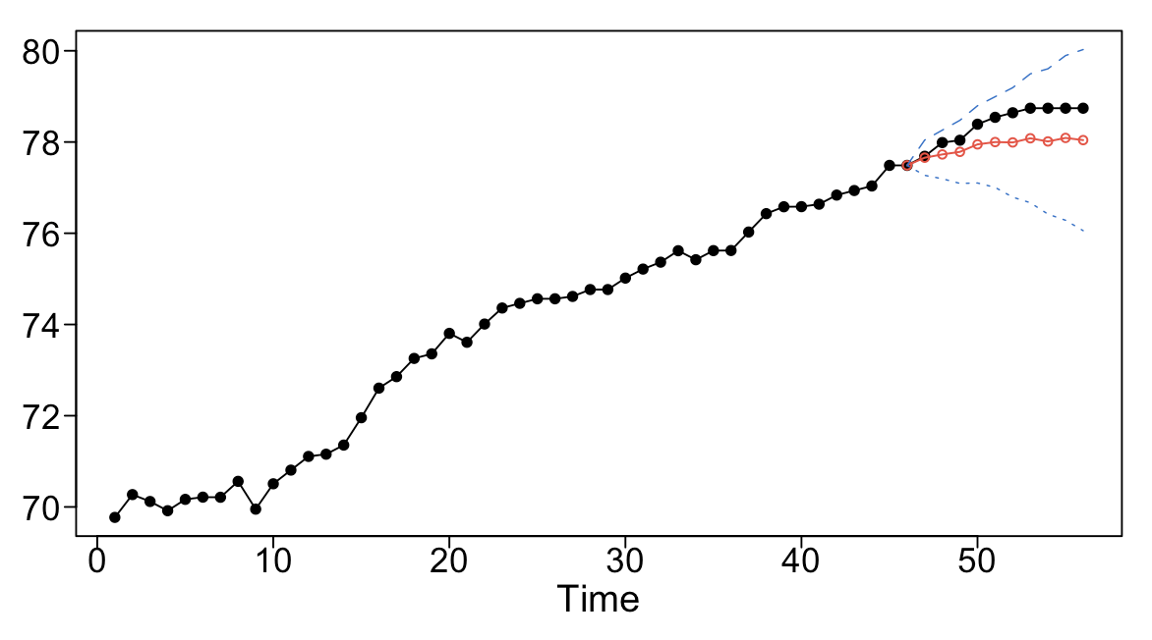
ARMA Models for United States
ARMA (7,1)
Long term Forecast of 10
ARMA (7,1) – Model 1 United States
5-year ASE | 0.03084328
5 year Rolling Window RMSE | 0.355
10-year ASE | 0.2926274
10-year Rolling Window RMSE | 0.633
Notes:
This does not seem to be accurate at all looking at the FCST

Slide 14
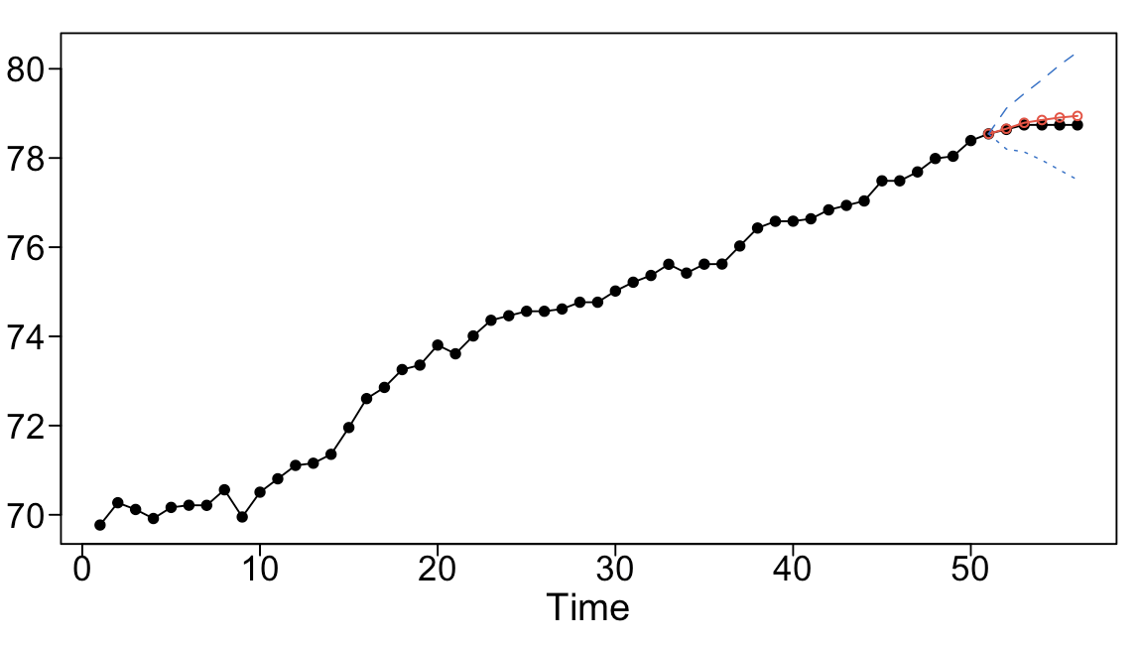
ARMA Models for United States
AR (4)
Short term Forecast of 5
AR(4) – Model 2 United States
5-year ASE | 0.01653549
5 year Rolling Window RMSE | 0.399
Notes:
AR(4) mostly accurate except for last 3 to 4 points

Slide 15
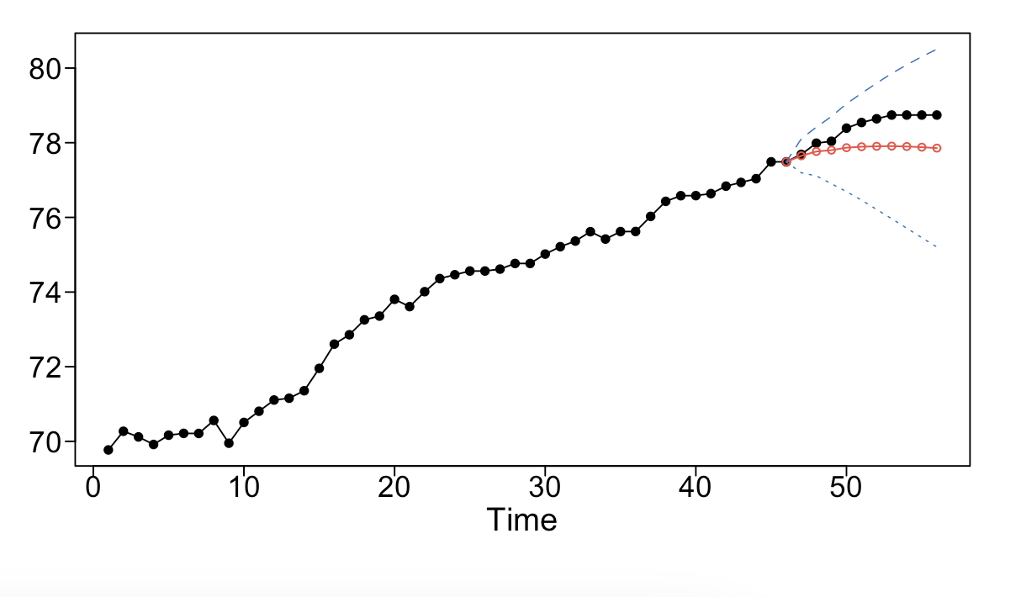
ARMA Models for United States
AR (4)
Long term Forecast of 10
AR(4) – Model 2 United States
5-year ASE | 0.01653549
5 year Rolling Window RMSE | 0.399
10-year ASE | 0.4274855
10-year Rolling Window RMSE | 0.745
Notes:
This does not seem to be accurate (only accurate for the first 2 points)

Slide 16
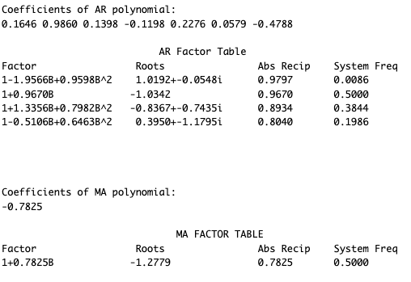
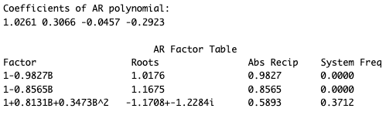
Factor Tables for US ARMA models
Model 1: ARMA (7,1)
Model 2: AR (4)
Notes:
Model 1 has 3 imaginary roots in the AR side
Model 1 AR side has 2 roots with absolute reciprocals closer to 1, indicating possible wandering behavior
Model 2 has an imaginary root in the AR side
Model 2’s AR side, has 2 roots that have roots closer to 1, indicating possible wandering behavior; there are also peaks at the spectral density at 0.

Slide 17
Summary of ARMA Models
Ideal Model for Mexico v. United States using ARMA
ARMA (5,2) – Model 1 Mexico
5-year ASE | 0.00007811939
5-year RW RMSE | 0.05
10-year ASE | 0.007747863
10-year RW RMSE | 0.269
ARMA (5,4) – Model 2 Mexico
5-year ASE | 0.00011528
5-year RW RMSE | 0.033
10-year ASE | 0.004462134
10-year RW RMSE | 0.181
ARMA (7,1) – Model 1 United States
5-year ASE | 0.03084328
5-year RW RMSE | 0.355
10-year ASE | 0.2926274
10-year RW RMSE | 0.633
AR(4) – Model 2 United States
5-year ASE | 0.01653549
5-year RW RMSE | 0.399
10-year ASE | 0.4274855
10-year RW RMSE | 0.745
Notes:
The ones w Thick black border are the “optimal” of the ARMA models; most useful
Make sure to mention how Rolling window RMSE is lower, and ASE is lower; If ase is lower for 5 year, but not as low in 10 year etc

Slide 18
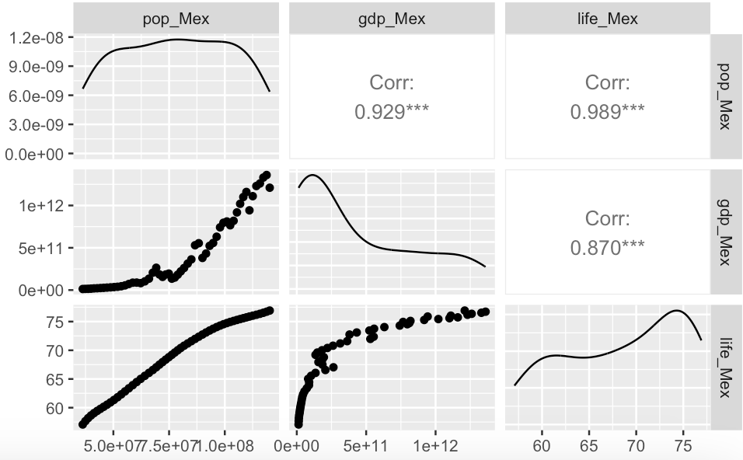
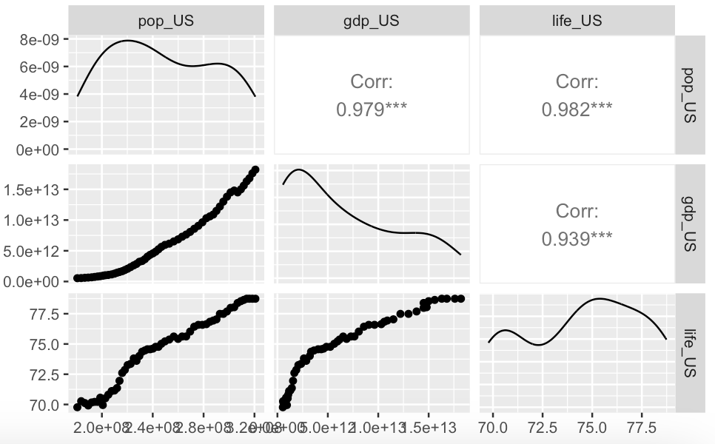
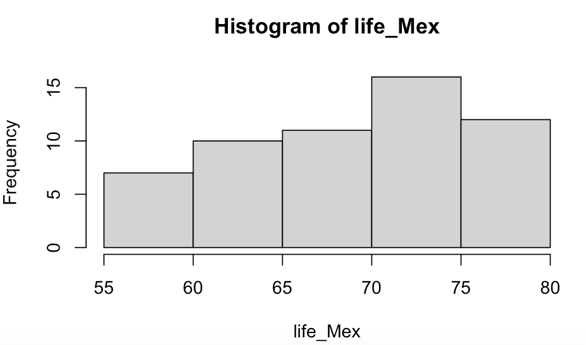
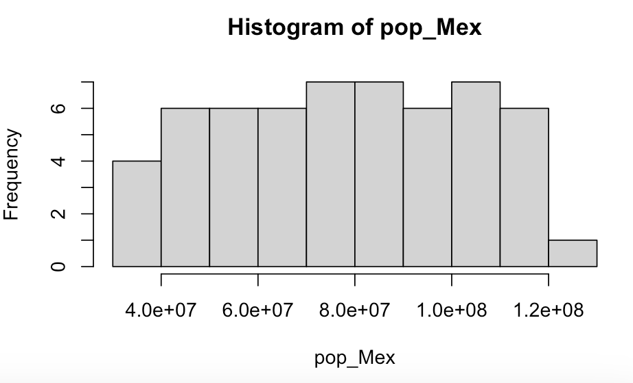
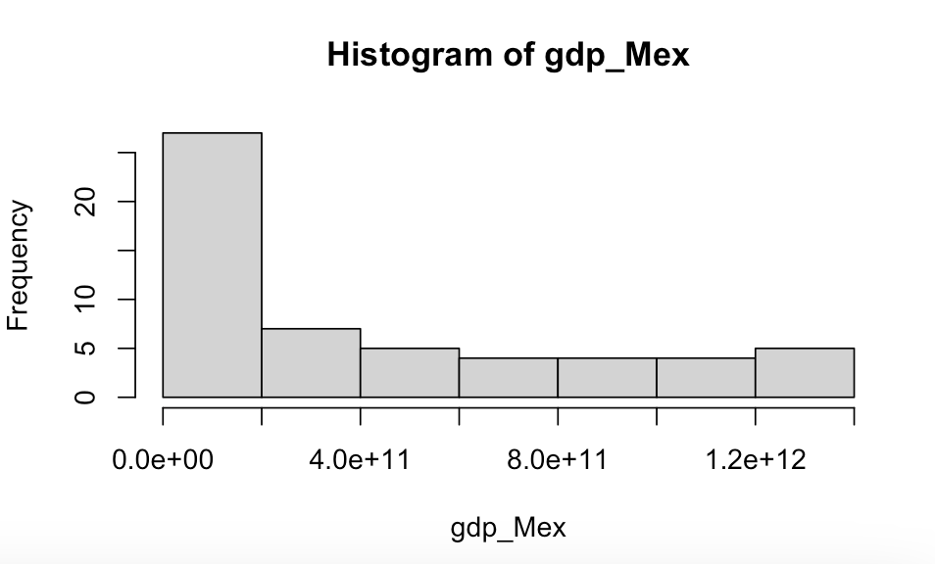
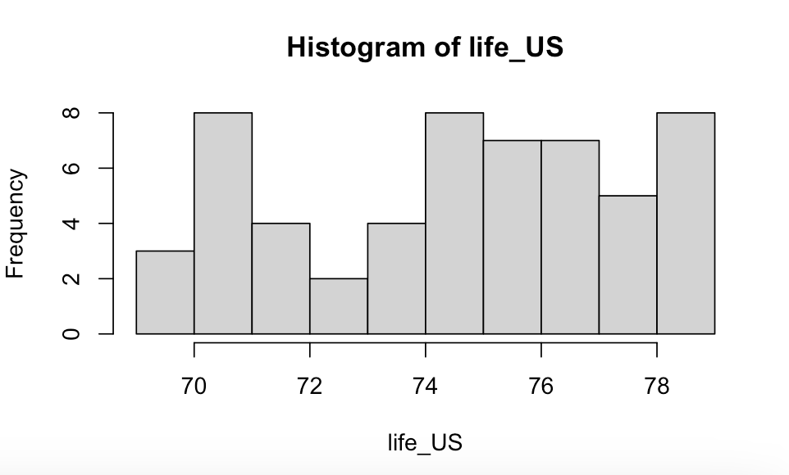
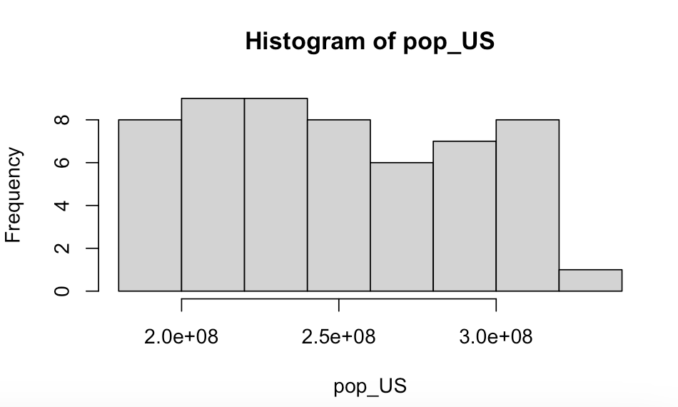
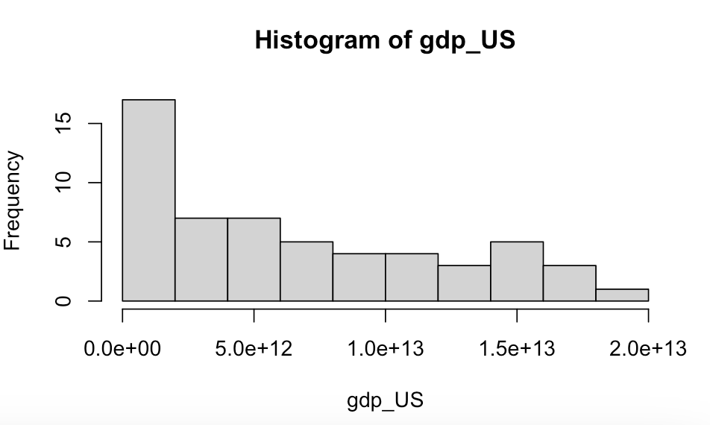
Another look at the Data
Mexico
United States
Notes:
Consider the correlated variables and data spread.
Not a lot of difference in GDP year to year.
To perhaps to improve for NN model the data could be scaled.

Slide 19
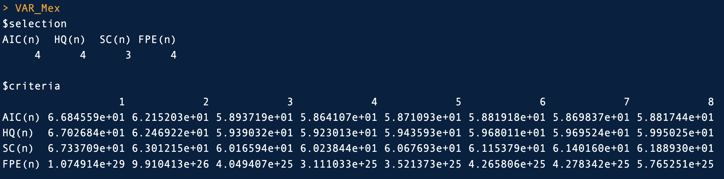
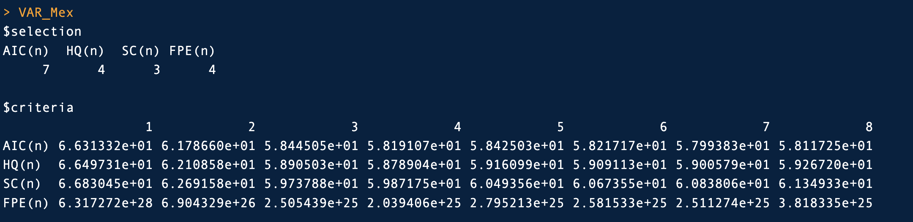
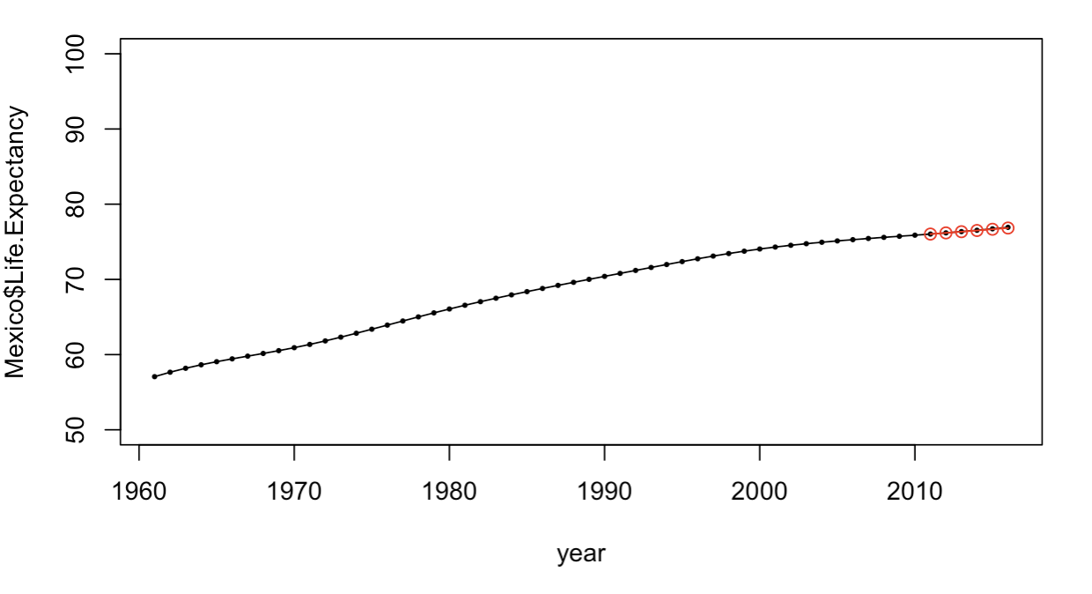
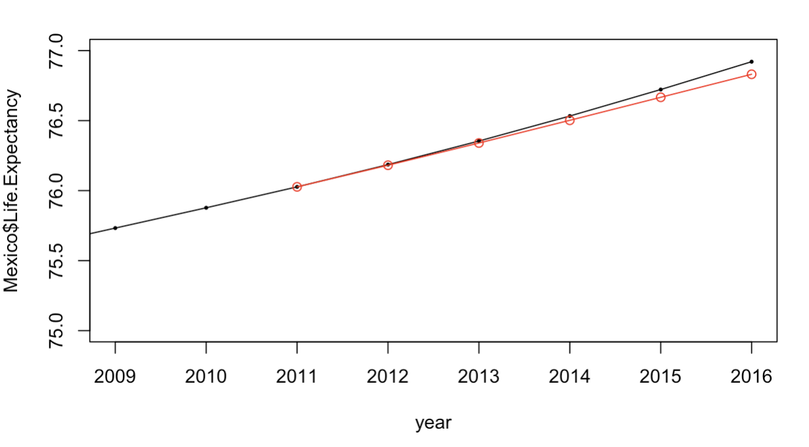
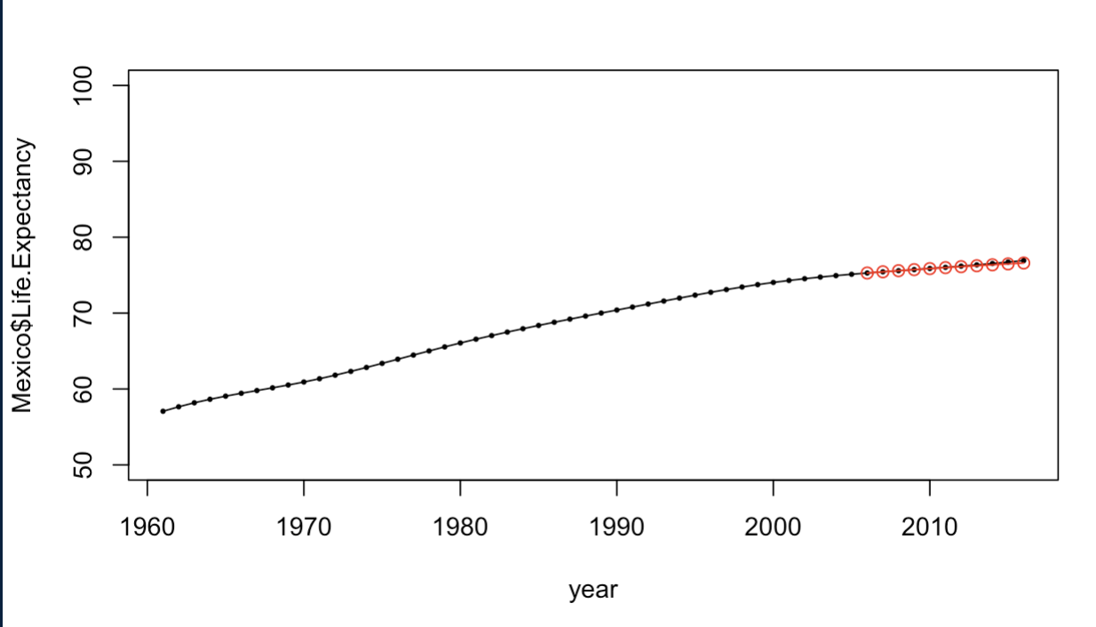
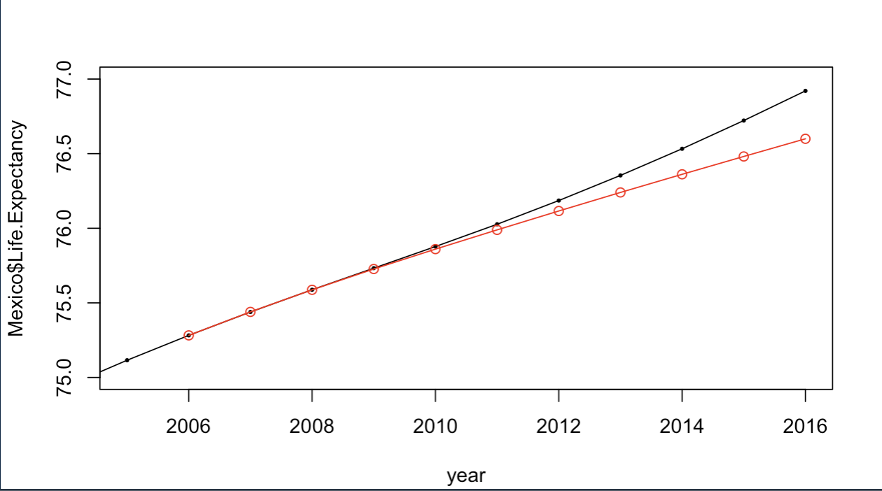
VAR Models for Mexico
5 Year – lowest AIC lag=4
10 Year lowest AIC lag= 7
Notes:
Given that our model variables are highly correlated, it was hypothesized that the VAR models may perform well.
VAR Select suggestions and respective forecasts.

Slide 20
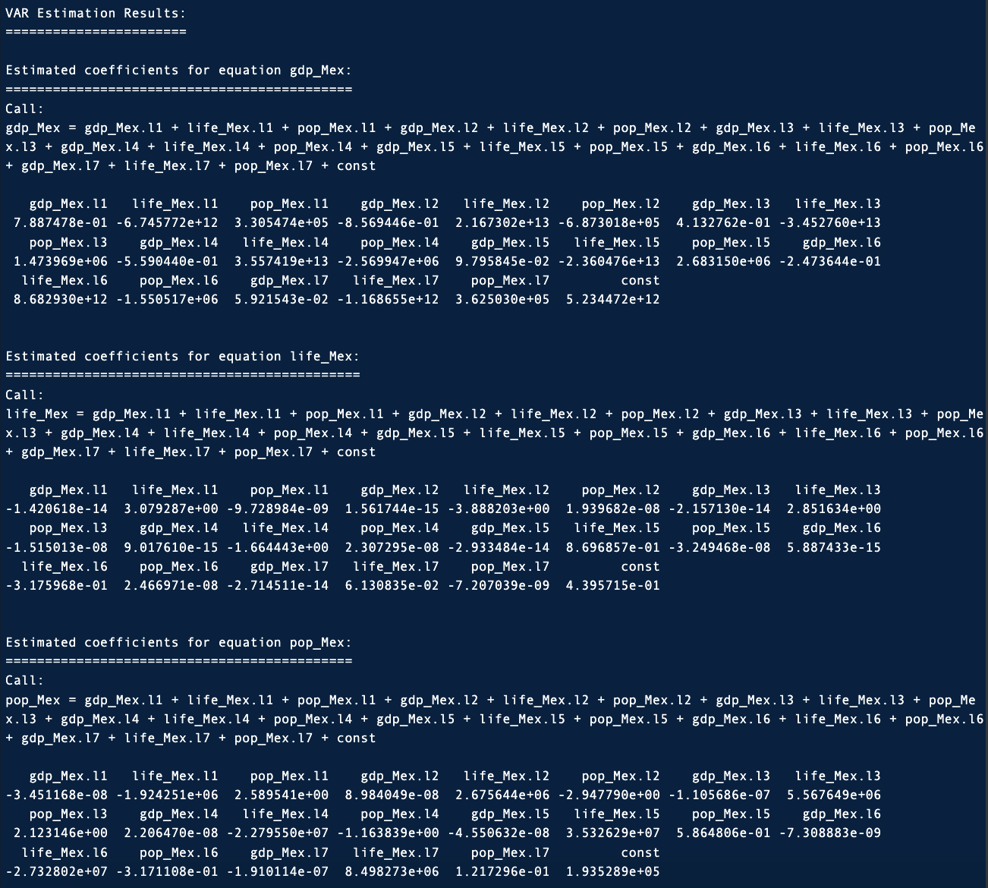
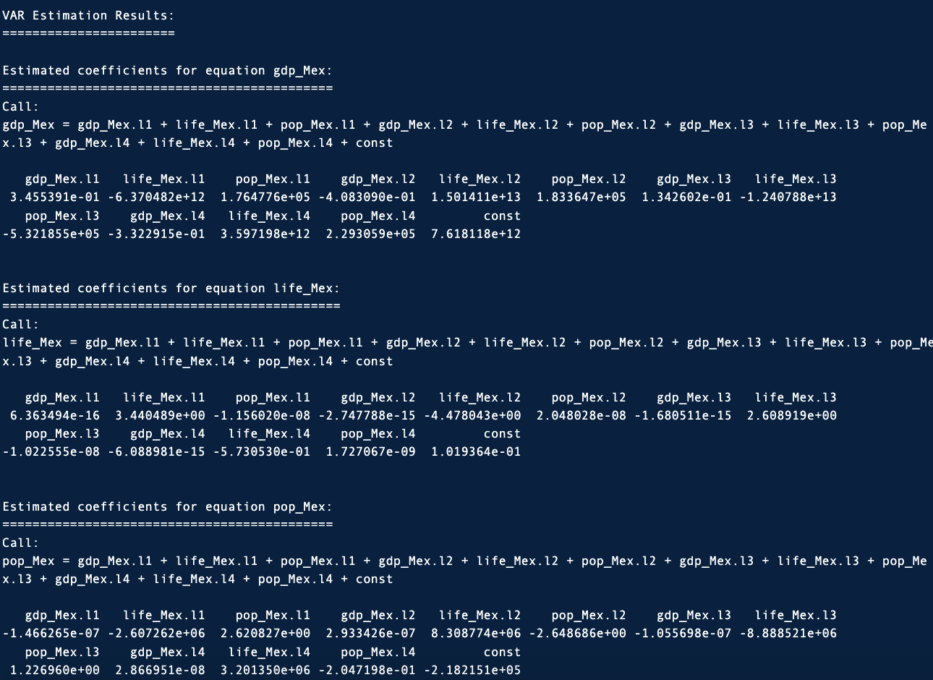
Var Estimated Coefficients: Mexico
5 Year – lowest AIC lag=4
10 Year lowest AIC lag= 7
Notes:
Using VARSelects suggestion, a lag of 4 is utilized for the short term and a long term lag of 7.
Here we see the VAR models respective estimated coefficients for both short and long term.

Slide 21
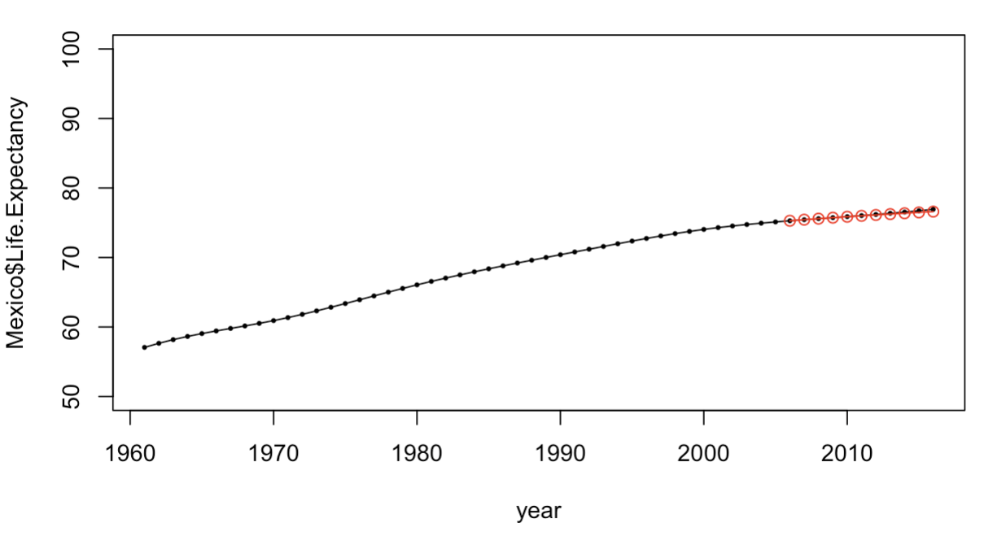
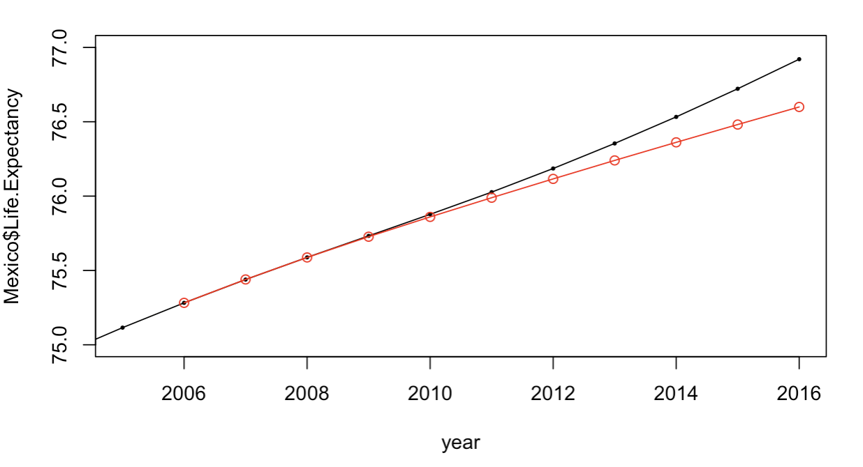
Summary VAR Models for Mexico
5 Year – lowest AIC lag=4
10 Year – lowest AIC lag=7
Mexico VAR Models
5-year ASE | 0.002455944
5-year RMSE | 0.04955748
10-year ASE | 0.02099135
10-year RMSE | 0.1448839
Notes:
The forecasts for the short and long term Var Models for Mexico.
SHORT TERM:
The forecasts for the short term at first seem to nearly overlap, on further inspection the short term 10th order VAR model is performing quite well. It does trail lower for the final two predictions.
LONG-TERM:
The forecasts for the long term 10th order VAR Model again similar to the short term forecast able to predict rather accurately the the first few years and again trails consistenly lower as predictions get further out in time.
Assessment:
The Var models for both long and short term forecasting were useful to detect the relationship between the data, and enhanced the forecasts the following ASE scores with the short term, forecasted model having a lower ASE. The short term 10th Order Var model appears to be more useful at predicting life-expectancy compared to a long-term forecast. However we can possibly do better with other modeling techniques.

Slide 22
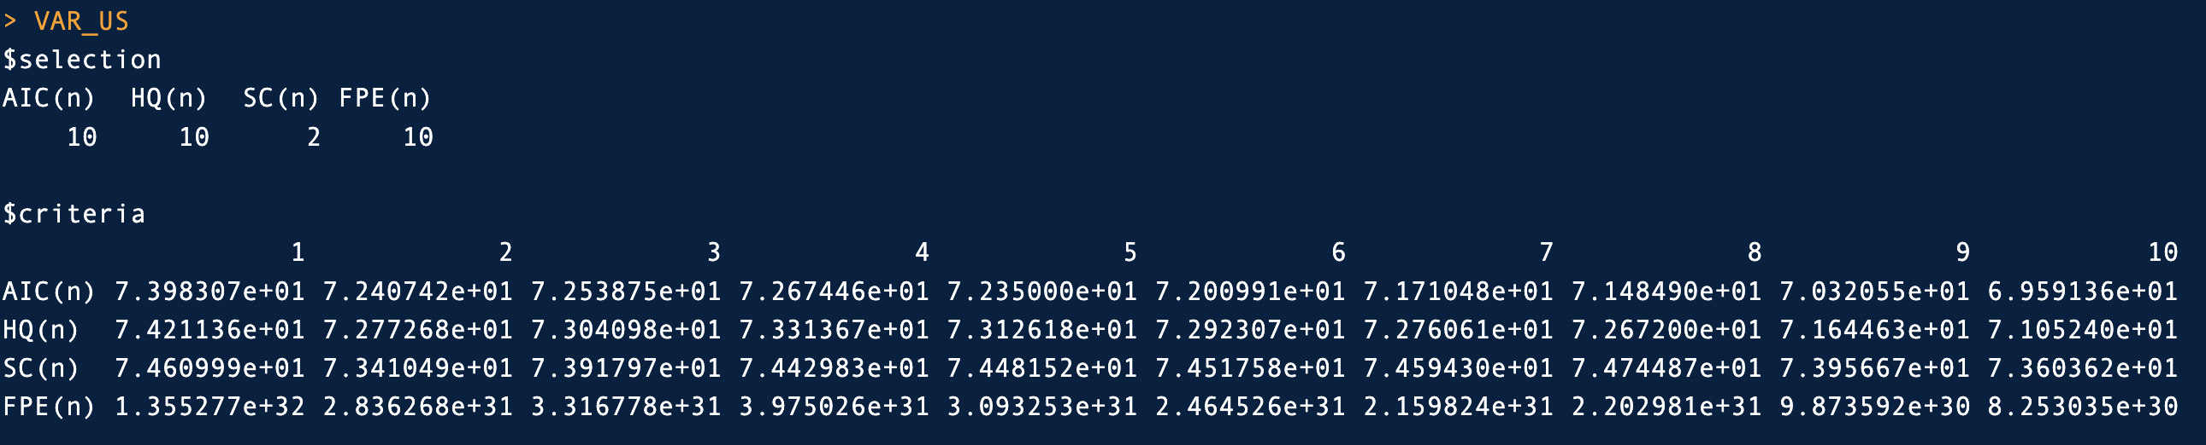
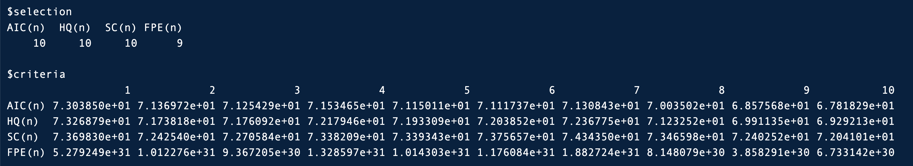
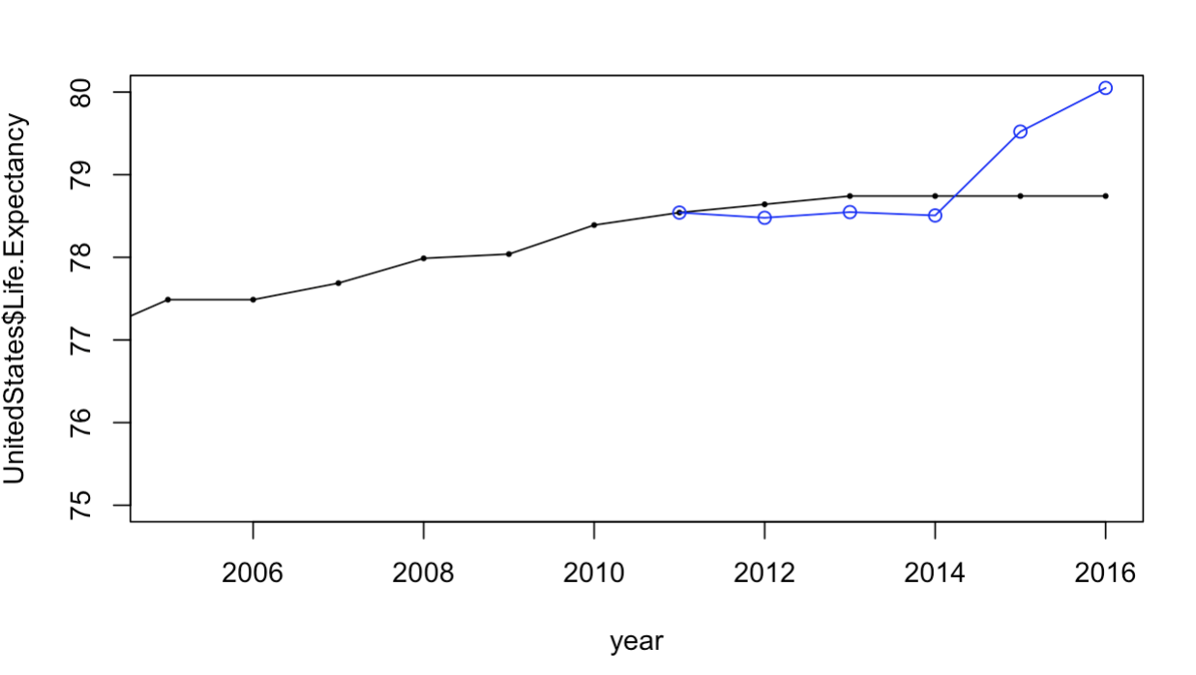
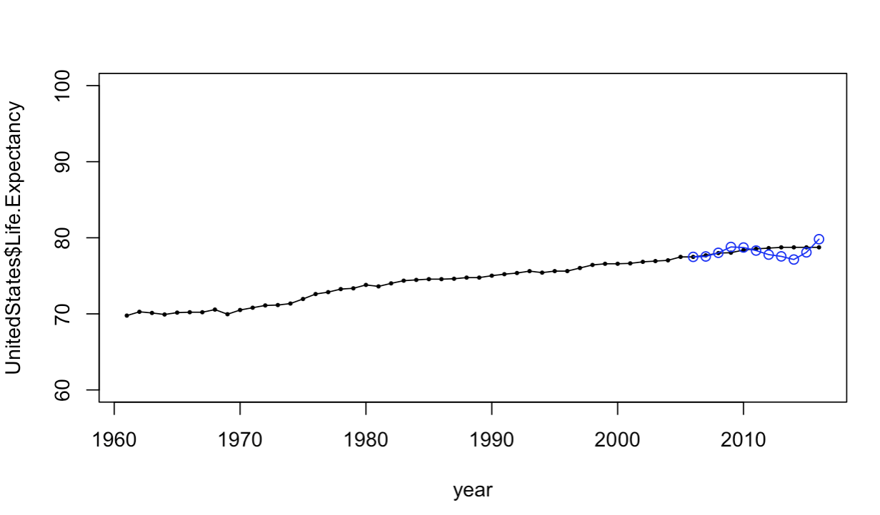
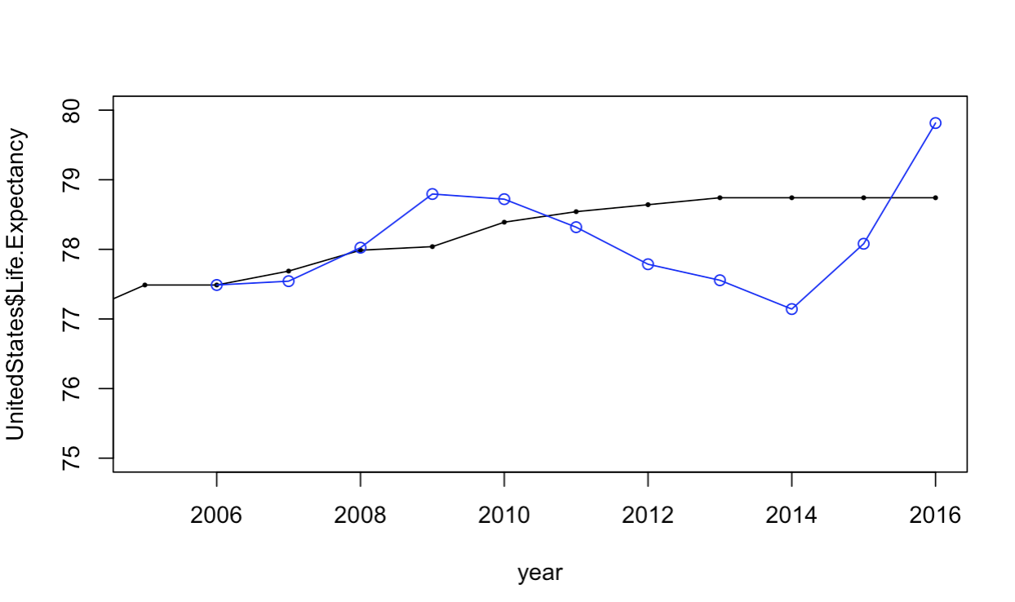
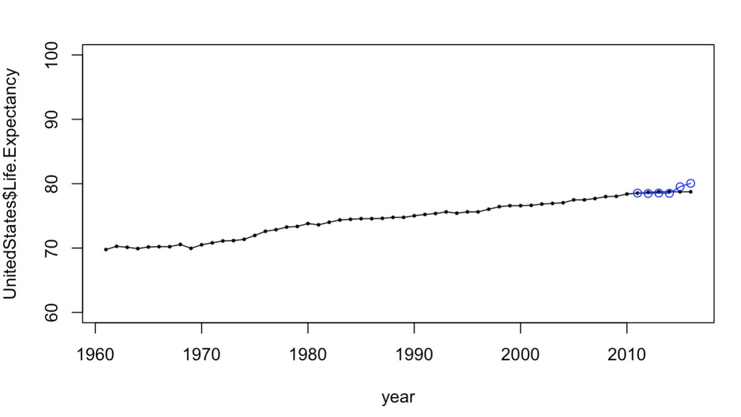
VAR Models for United States
5 Year – lowest AIC lag=10
10 Year lowest AIC lag=10
Notes:
Given that our model variables are highly correlated, it was hypothesized that the VAR models may perform well.
VAR Select suggestions and respective forecasts.

Slide 23
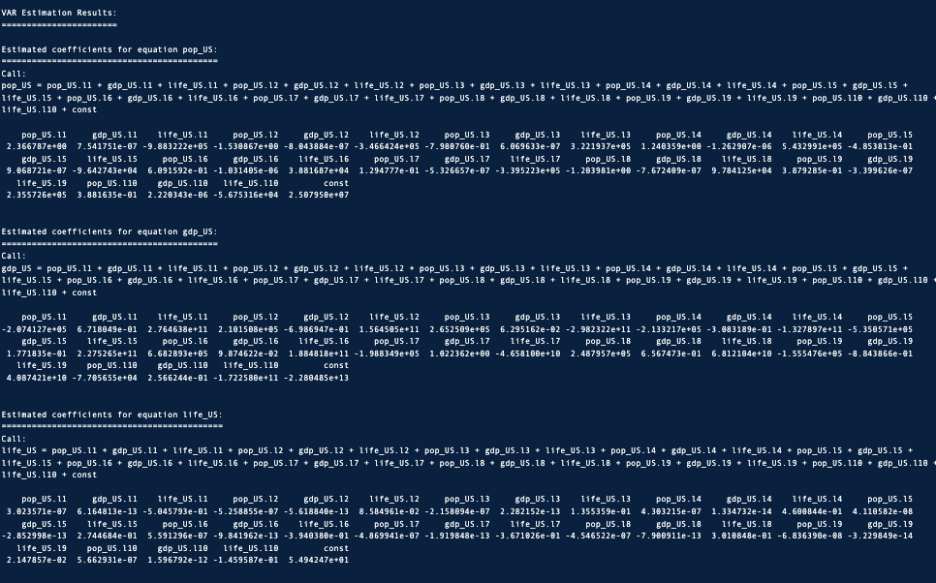
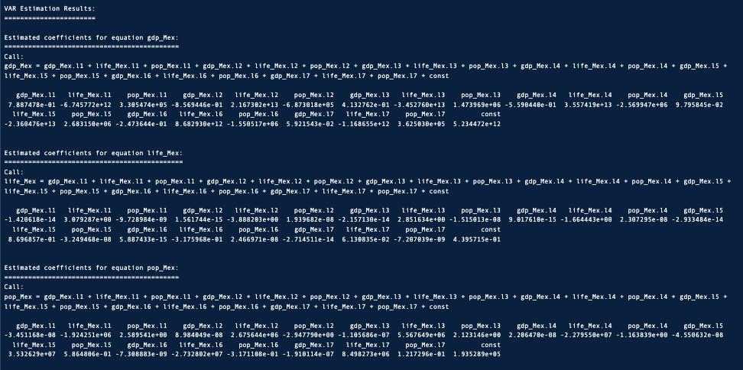
Var Estimated Coefficients: United States
5 Year – lowest AIC lag=10
10 Year lowest AIC lag= 10
Notes:
Here we see the estimated coefficients for each respective VAR Model for the United States. There are numerous values so it is difficult to read.

Slide 24
Summary VAR Models for United States
5 Year – lowest AIC lag=10
10 Year – lowest AIC lag=10
United States VAR Models
5-year ASE | 0.4878381
5-year RMSE | 0.6984541
10-year ASE | 0.7036564
10-year RMSE | 0.8388423
Notes:
The forecasts for the short and long term Var Models for United States.
SHORT TERM:
The forecasts for the short term at first seem to nearly overlap, but on further inspection we see that the predictions were consistently lower for the first three years, and wandered higher for the last two years forecasted.
LONG-TERM:
The forecasts for the long term 10th order VAR Model again similar to the short term forecast able to predict rather accurately the the first three years, but the next 8 oscillate high then low before rising again.
Assessment:
The Var models for both long and short term forecasting were useful to detect the relationship between the data, and enhanced the forecasts and had an ASE the following ASE scores with the short term, forecasted model having a lower ASE. The short term 10th Order Var model appears to be more useful at predicting life-expectancy compared to a long-term forecast. However we can possibly do better with other modeling techniques.

Slide 25
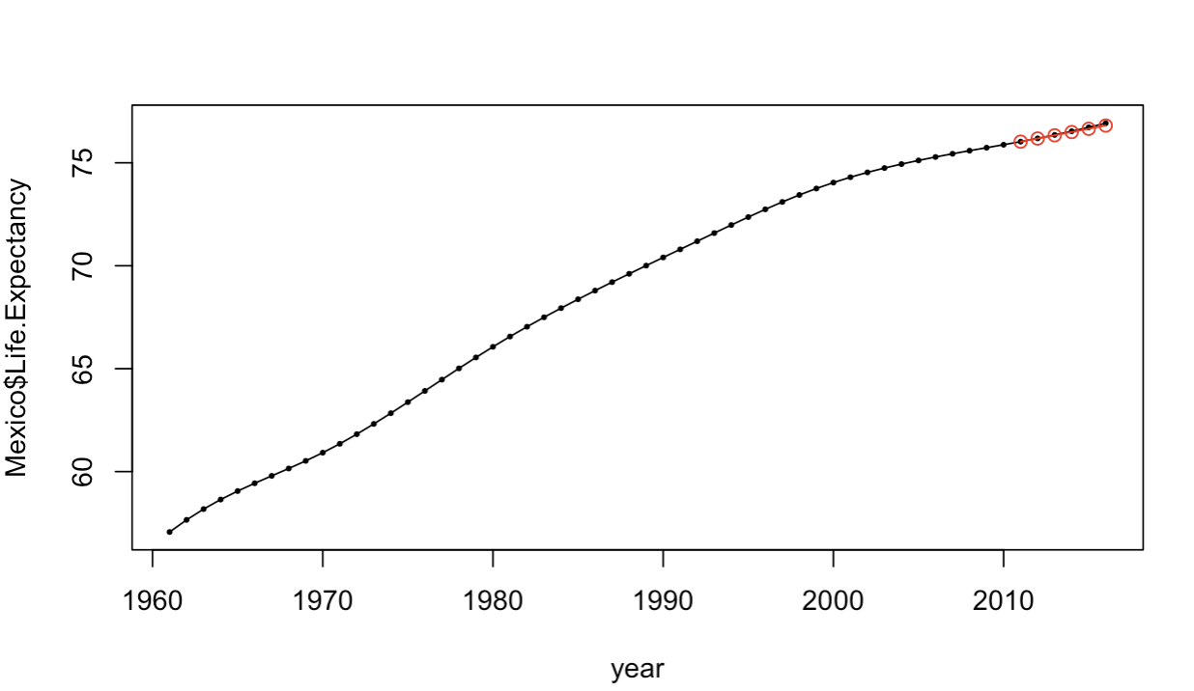
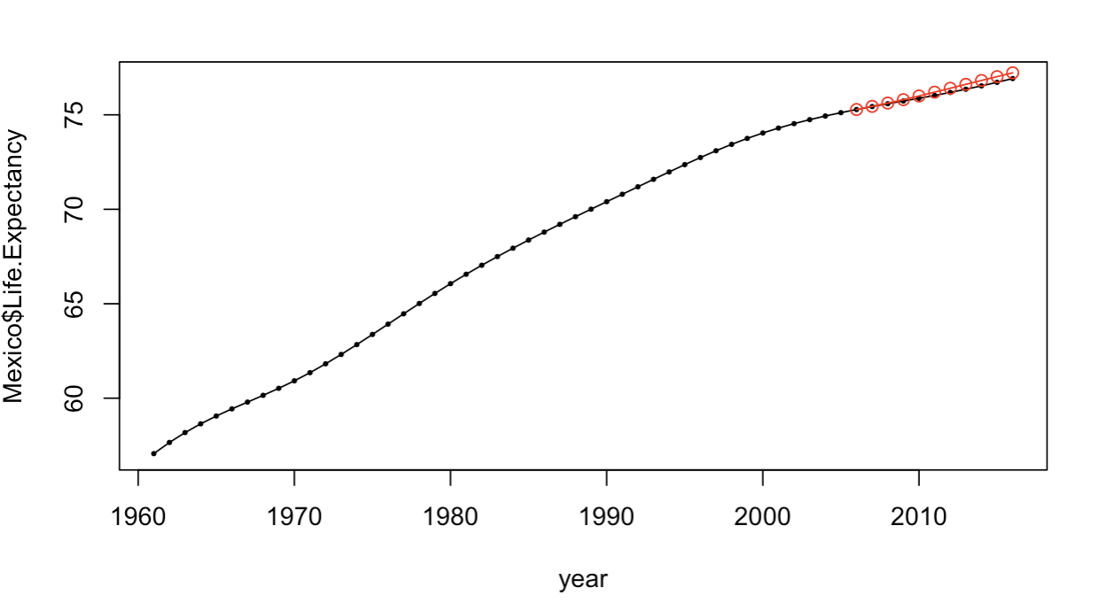
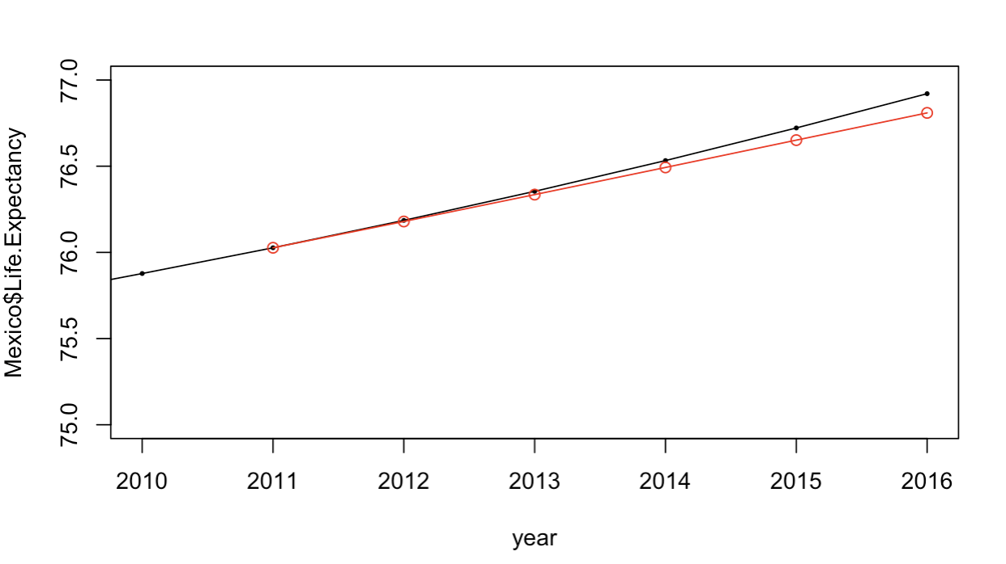
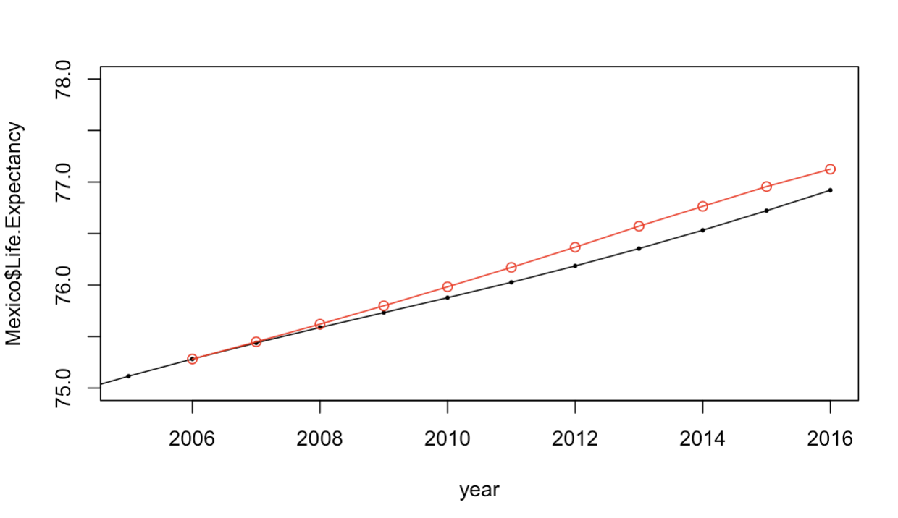
Summary MLP Models for Mexico
5 Year
10 Year
Mexico MLP Models
5-year ASE | 0.005730392
5-year RMSE | 0.07569935
10-year ASE | 0.02526074
10-year RMSE | 0.1589363
Notes:
Another model we tried was the Multilayer perceptron, using the mlp function in the nnfor package.
SHORT TERM: Again similar to the previous VAR Model selected, the MLP is able to predict the first three years well and trails off lower as it approaches the 5th year forecast.
LONG TERM: Here its interesting, that in the short term forecasts it trailed lower than the actual values for life expectancy on the 4th and 5th year, in the long term forecast the MLP model trails slightly higher than the actual values from years 2-10.
Overall both short and long term models appear to be useful with low ASE for a 5 year forecast, lower than that of the long-term forecast ASE.

Slide 26
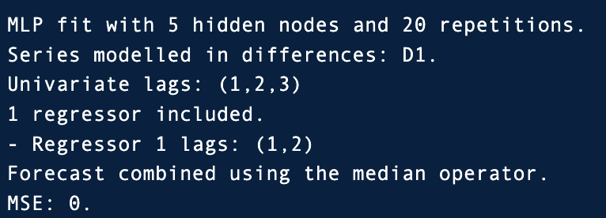
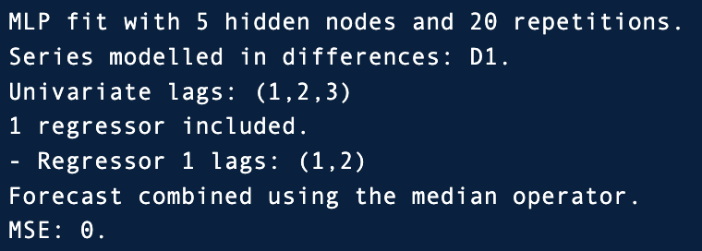


MLP Models: Mexico
5 Year
10 Year
Notes:
Here we see the MLP models framework and their 5 hidden layers, 20 reps, with 1 regressor for each.

Slide 27




Summary MLP Models for United States
5 Year
10 Year
United States MLP Models
5-year ASE | 0.4465622
5-year RMSE | 0.6682531
10-year ASE | 0.07298946
10-year RMSE | 0.2701656
Notes:
Another model we tried was the Multilayer perceptron, using the mlp function in the nnfor package.
SHORT TERM: Almost immediately the MLP prediction are higher than that of the actual values and seem to be wandering higher
LONG TERM: On a longer time frame, the forecasts seems to capture the trend of the actual observations while not exactly hitting the actual values, but two predicted values were nearly spot on.
Overall the short-term model does not appear to be useful. The long-term model however seems quite useful and capturing the data. This is reflected in the ASEs, long-term ASE significantly lower than that of the short term model.

Slide 28



MLP Models: United States
5 Year
10 Year
Notes:
Here we see the MLP models framework and their 5 hidden layers, 20 reps, with 1 regressor and an MSE of 0.0162.
The Long-term MLP model framework is slightly different with 2 regressions and a lower MSE of 0.0132.

Slide 29




Ensemble (VAR & MLP) for Mexico
5 Year
10 Year
Mexico Ensemble Models
5-year ASE | 0.004415432
5-year RMSE | 0.06644871
10-year ASE | 0.001717489
10-year RMSE | 0.04144259
Notes:
Given that the VAR and MLP models were not useless models, let’s use the combo of models to create a multivariate ensemble model to see how well it performs.
The Mexico predictions for both short-term and long-term have very low ASEs, with the long-term forecast having the lower ASE. When we zoom in the long-term forecast using the ensemble method appears to be quite useful.

Slide 30




Ensemble (VAR & MLP) for United States
5 Year
10 Year
United States Ensemble Models
5-year ASE | 0.4065556
5-year RMSE | 0.6376171
10-year ASE | 0.2510273
10-year RMSE | 0.5010262
Notes:
Given that the VAR and MLP models were not useless models, let’s use the combo of models to create a multivariate ensemble model to see how well it performs.
The United States predictions for both short-term model performs worse as compared to the longer-term forecasts. The Shorter term model looks to be wandering higher and perhaps is not useful as the long-term model which shows the models is capture some trend around in the data to oscillate low then high around the actual predictions.

Slide 31


Comparison: Short-Term 5-year Forecast
Country/Model | ASE
Mex VAR | 0.002455944​
Mex MLP | 0.005730392
Mex Ensemble VAR & MLP | 0.004415432
US VAR | 0.4878381​
US MLP | 0.4465622​
US Ensemble VAR & MLP | 0.4065556
Mexico
United States
Notes:
The ensemble combo of VAR and MLP did not perform well compared to either VAR or MLP models.
Looking at the shorter term forecast we see that the lowest ASE model for the US was the ensemble combo of 10th Order Var and MLP Model.
For Mexico, the most useful model at predicting life-expectancy was the 4th Order VAR model.

Slide 32


Comparison: Long-Term 10-year Forecast Summary
Country/Model | ASE
Mex VAR | ​0.02099135
Mex MLP | 0.02526074​
Mex Ensemble VAR & MLP | 0.001717489
US VAR | 0.7036564​
US MLP | 0.07298946
US Ensemble VAR & MLP | 0.2510273
Mexico
United States
Notes:
The ensemble combo of VAR and MLP did not perform well compared to either VAR or MLP models.
Looking at the shorter term forecast we see that the lowest ASE model for the US was the ensemble combo of 10th Order Var and MLP Model.
For Mexico, the most useful model at predicting life-expectancy was the multivariate ensemble (combo of 7t^{th} Order VAR model and Multivariate Preceptron Model).

Slide 33
Submit Questions to:
tcabaza@smu.edu
rkarthikeyan@mail.smu.edu
Notes:
Thank you for your time; if you have any questions, please feel free to reach out to us; our emails are listed above

